Slide 1
Leading Your Way Out of Technical Debt
Arlo Belshee
@digdeeproots

Slide 2

Case Study
104 teams
Same company
3 different products
A ton of code sharing
Notes:
2m
Wanted to do Continuous Delivery. But couldn’t, because bug rates were too high, thus validation high.
Asked each team what the problem was. Clustered the problems & assigned votes.
Median item got 1 vote. Max item got 3 teams that thought it was their problem to solve, 3 that wanted someone to solve it for them – but not the 3 who thought it was theirs.

Slide 3

The Impossible Situation
No consistent problem was found…
YET…
Leaders set a consistent direction
Others go that direction
That won’t work for technical debt.
Notes:
.5m

Slide 4

A New Kind of Leadership
Multiple directions with alignment.
Notes:
.25m
We need companies to go in many different directions in an aligned way.

Slide 5

Requires Everyone to Shift
New behaviors in every role
Notes:
.25m

Slide 6
Accountability Loop
What We Do Today
Team
Leader
Commitment
Direction
Execute
Feedback
Assess
Notes:
.5m

Slide 7

Impact on Technical Debt?
What Happened:
4 years total invested
30% dev effort dedicated
2 years holding consistent direction
Notes:
1m
Company had been trying this for 4 years, including major investments of 30% of all dev effort, with consistent direction held for 2 years. No significant results.

Slide 8
Ownership Loop
Team
Leader
Assess
Commitment
Direction
Execute
Feedback
Direction
Assess
Notes:
.5m

Slide 9
Ownership Loop
Team
Leader
Assess
Mentor
Coach
Challenge
Execute
Direction
Notes:
.5m

Slide 10

Impact on Technical Debt?
What Happened:
2 orgs tried ownership loop
Measurable progress within 1-2 months on each team
Each team going after their specific pain
Notes:
1m

Slide 11
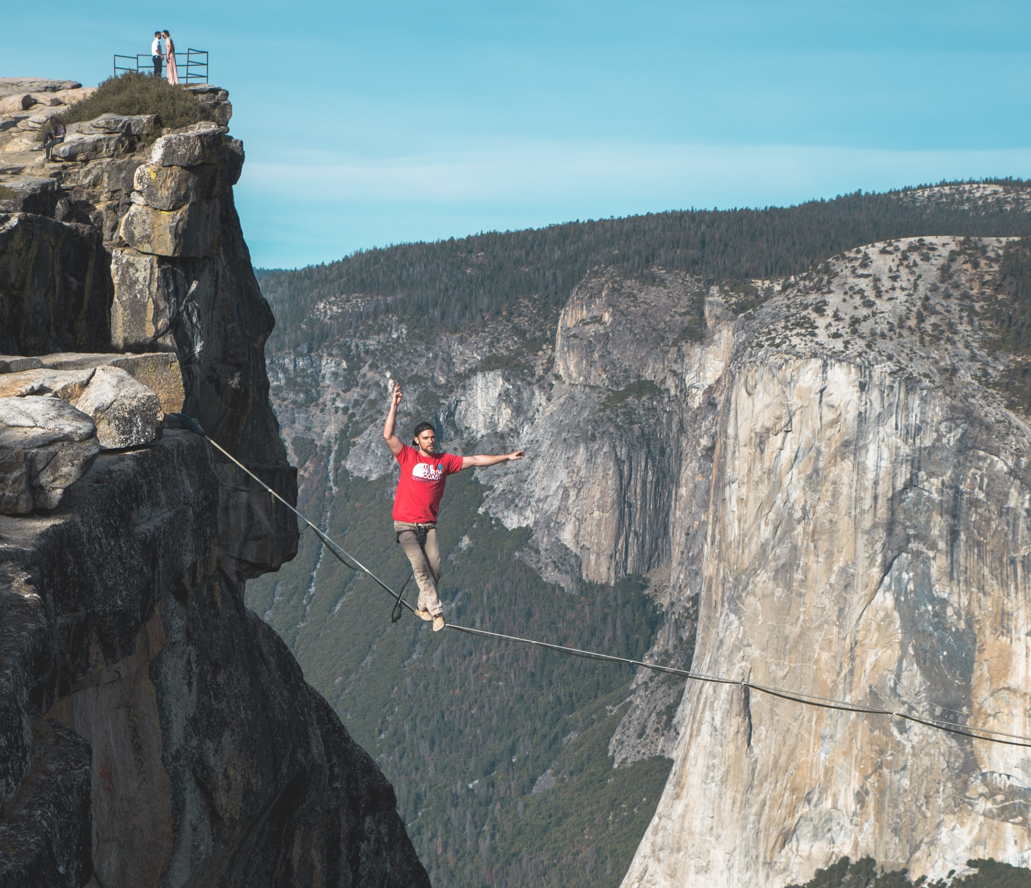
Except that Breaks Leaders
Leaders…
make decisions,
improve people, and
ensure the right work gets done
Notes:
.5m
The job definition for leaders is not what we need.

Slide 12
Ownership without breaking leaders
Leaders stop…
Leaders start…
make decisions,
improve people, and
ensure the right work gets done
coach decision ability
mirror people, and
point out blind spots
Notes:
1m

Slide 13

If we succeed implementing those?
AUTONOMY
RESPONSIBILITY
ACTION
ALIGNMENT
Notes:
.5m
Balance team autonomy with responsibility. Autonomy doesn’t go wild; leaders don’t stifle action.
And this allows local alignment and action, without requiring global alignment. Exactly what we need in order to solve Technical Debt.

Slide 14
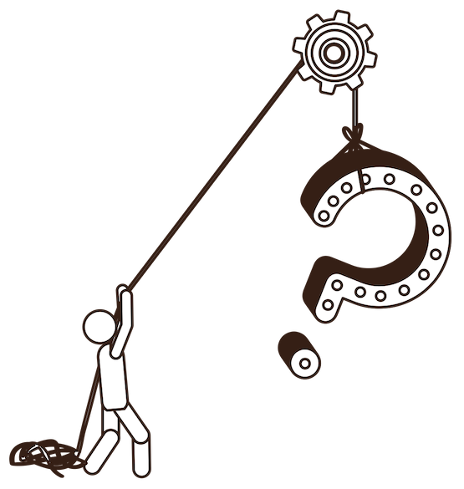
Sounds great in theory, but…
Notes:
.25m

Slide 15
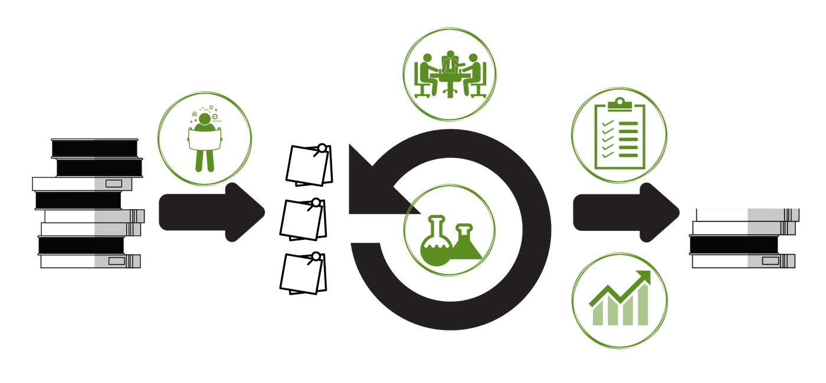
Let’s Break Down GROw™
Notes:
.25m
We have a framework for doing this in practice. It consists of modifications to any iterative method.

Slide 16





Let’s Break Down GROw™
Adjusts your planning: plan different work
Adjusts your sprint: do and track work differently
Adds an ownership event: leaders help teams build ownership
Adjusts assessment: ownership over commitment
Adjusts your demo: talk about success differently
Notes:
1m

Slide 17
Part 1: Planning Experiments
Individual teams identify and agree upon metrics and experiments that they locally need.
NEW CONCEPT: experimentation versus improvement
Notes:
.5m

Slide 18
Part 2: Running Experiments
Tracking measurements and experiments throughout sprint.
NEW CONCEPT: None
Notes:
.25m

Slide 19
Part 3: Leading Ownership
Creating a regular structure for leaders to support teams achieving greater and greater ownership over time.
NEW CONCEPT: stances - how leadership and teams show up
Notes:
.5m

Slide 20
Part 4: Assessing Ownership
Finding a clear picture of where every team is and what is possible
NEW CONCEPT: a reflection of moving from accountability to ownership
Notes:
.25m

Slide 21
Part 5: Showing Improvement
Demo turns into product and productivity demo
NEW CONCEPT: experimentation versus improvement
Notes:
.5m

Slide 22

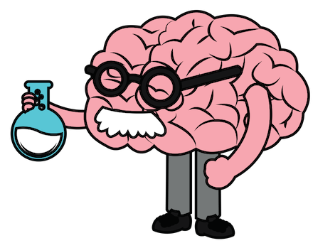
New Concept #1: Experimenting vs Improving
Notes:
2m
Experiment vs improvement
The purpose of an improvement is to directly reduce debt – you know your ROI
The purpose of an experiment is to learn what improvements should be done later – you’re finding the ROI
Understanding the proper ratio between experiments and improvements

Slide 23
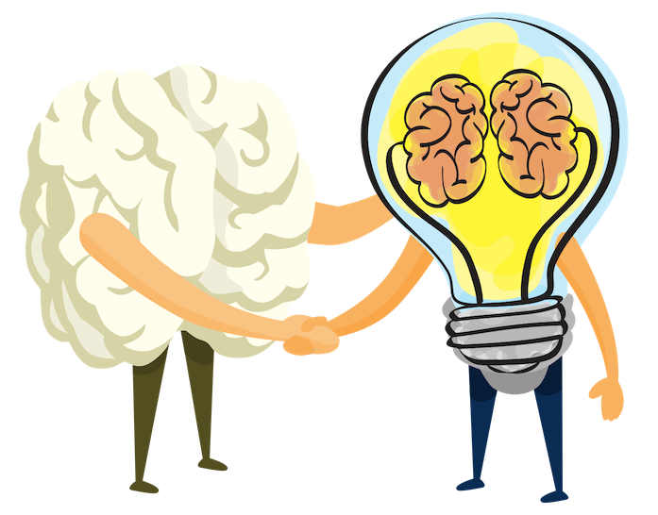
New Concept #2: Shifting Stance
Notes:
2m
Shifting from task to mindset – ACTUALLY trusting the teams to run your business. How many dollars do you lose by letting teams screw up versus how many dollars do you lose by NOT letting teams innovate?
And yes, there is a way to do this without leaders losing their jobs!
Craig: work on my goal -> define how you would measure. They started measuring & improving. In next re-org, he moved up 2 levels.

Slide 24



Leader Stance
Notes:
1m

Slide 25
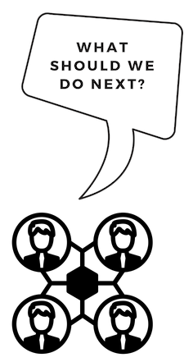

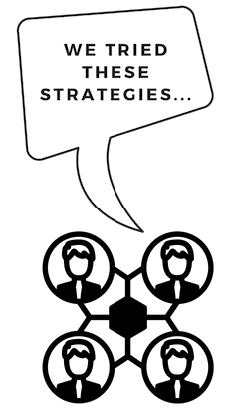
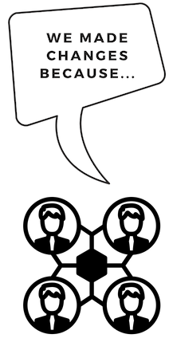

Team Stance
Notes:
1m

Slide 26
Leading Ownership – Skills Required
It just takes practice and intentional awareness … let’s start now!
Find the Stance Handout
Find a partner and choose roles
Read the scenario
Roleplay your role
Swap roles and roleplay
3:00
2:45
2:30
2:00
1:45
1:30
1:15
1:00
0:45
0:30
0:15
0:00
3:00
2:45
2:30
2:00
1:45
1:30
1:15
1:00
0:45
0:30
0:15
0:00
3:00
2:45
2:30
2:00
1:45
1:30
1:15
1:00
0:45
0:30
0:15
0:00
Notes:
10m

Slide 27
Leading Ownership – Debriefing
Leader roles, did you find yourself…
Team roles, did you find yourself…
Mistrusting the data?
Offering solutions?
Asking for a commitment?
Asking what to do?
Asking about priorities?
Convincing the leader?
Yeah. It’s hard. I do offer workshops. /innocent/
Notes:
2m

Slide 28
Everybody Shifts
Notes:
.25m
This kind of leadership requires different behavior out of everybody

Slide 29

Create your chain reaction…
Notes:
.25m
But that means that it can be started by anybody

Slide 30
Change how you participate…
Product Owner, Team Manager, Individual Contributor, Executive
Notes:
.25m

Slide 31
How to Start – Product Owner
demand tech debt plan
don’t assume tech debt is unsolvable
Notes:
1m
Accept it as a reason that X can’t happen, and then ask for that reason to start changing this sprint

Slide 32
How to Start – Team Manager / Lead
designate data champion
play exec role
ask real exec to take over
Notes:
1m

Slide 33
How to Start – Any Individual Contributor
BE the tech debt data owner
present differently at demos
define incremental tech debt improvements / experiments
work with the PO to make consumable
start doing Disciplined Refactoring
(I offer a workshop)
Notes:
1m

Slide 34
How to Start – Exec
educate accountability cycle vs ownership cycle
start the Leading Ownership step
find accountability cycles and change them
(I offer workshops)

Slide 35

The way we work…
Weekly: explore 1 practice
Mondays: receive experiment
Fridays: analysis and additional resources
Subscribe for free 5-week discovery of your patterns
http://bit.ly/Discover_GROw
Pay for a coached behavior change on experimentation, ownership, or showing ROI
sales@digdeeproots.com
Notes:
.25m

Slide 36
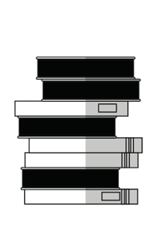
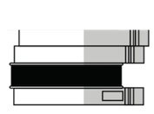
The Choice is Yours; the Reward is Simple
You get to start fixing technical debt …. Tomorrow.
Notes:
1m

